Slide 1
The University of Akron
Student Health Services
Marisa Porter, BSN, RN
healthservices@uakron.edu

Slide 2
Student Health Services
Location:
Inside the Recreation and Wellness Center
2nd floor, Suite #260
Contact Information:
382 Carroll Street, Suite 260
Akron, Ohio 44325-1101
330-972-7808
healthservices@uakron.edu
Visits are primarily via scheduled appointments
Walk-ins are based on availability
Notes:
Parking is available in lots 8 and 10 off Spicer St behind the SRWC and lot 13 on Carroll Street

Slide 3
Student Health Services
Academic Year Hours:
Monday through Friday
8:00am to 5:00pm
Closed daily from 12:00pm to 1:00pm for lunch
Summer Hours:
Monday through Friday
8:00am to 4:30pm
Closed daily from 12:00pm to 12:30pm for lunch
Notes:
Parking is available in lots 8 and 10 off Spicer St behind the SRWC and lot 13 on Carroll Street

Slide 4

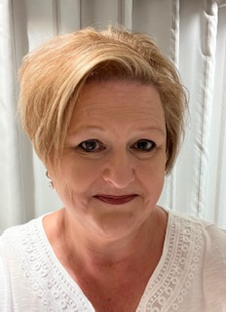

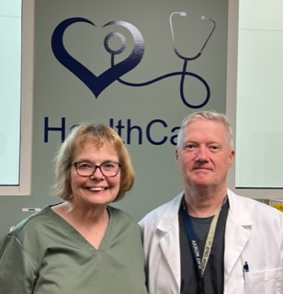

Staffing
Board-Certified Family Nurse Practitioners
Registered Nurse
Licensed Practical Nurse
Medical Secretary
Notes:
Dr. Harbert is the acting collaborating physician as required by Ohio law. He is a family medicine physician at Unity Health Network in Cuyahoga Falls. He is available for NP consultation but does not actively see patients on campus.

Slide 5
Services
Services are available to enrolled degree seeking students and employees of the University of Akron
Diagnosis and treatment for acute illnesses and injuries
Physical exams for university related programs and employment
Diagnostic blood work
In-office rapid testing for Strep, Flu, Covid, rapid urinalysis and pregnancy testing
On site medications (antibiotics, cough/cold medications, non-narcotic pain medications, topical creams/ointments, oral birth control, Plan B, oral steroids, antifungals, antidepressants, inhalers, and eye and ear drops)
Nebulizer treatments, ear irrigations, suture/stitch removals (cannot place)
Purchase or rental of crutches
Screening and treatment of sexually transmitted infections
Free sexual health preventative products: condoms and dental dams
Women’s health/wellness needs including PAP smears and contraceptive counseling
Men’s health/wellness needs
Vaccines and injection assistance
Flu Vaccine Clinics in October every year
Allergy injections in collaboration with an established Allergist practice
Medical management of uncomplicated anxiety and depression; management is in collaboration with the Counseling and Testing Center on campus or a patient’s off-campus therapist/counselor
Alcohol and other drug use/misuse screenings
Guest presentations and campus tabling events on a variety of health and wellness topics
Notes:
We do not see employees with work related injuries or worker’s compensation cases.
Medications are provided as part of a visit with the provider.

Slide 6
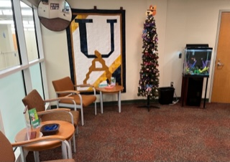
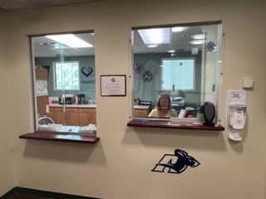
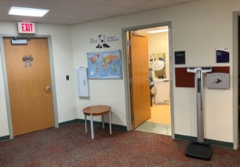
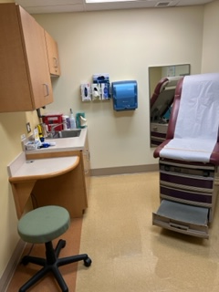
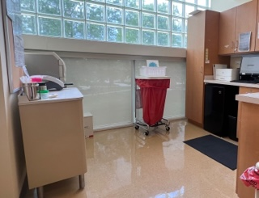
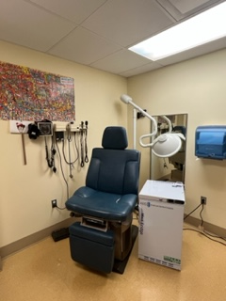
Health Services Office Tour
Notes:
Planning to offer a relaxed mental health consultation/treatment room in the Fall with comfortable seating and options to do bright light therapy during the winter months. Bright light therapy helps with seasonal affective disorder, especially in the winter when people feel more depressive symptoms due to lack of vitamin D from the sun.

Slide 7
Clinic Service Fees
Payment is due at the time of service. Most visits start at $15.00 (follow-up visits are $5 and physical exam visits are $35) with additional charges for testing, supplies, and/or medications. Average visit cost including onsite testing and medications is $25.00.
We accept cash, credit cards, Apple Pay, and Zipcards (All-Campus dollars only)
We do not bill insurances or HSA cards for services provided within the clinic (visit fees, rapid testing, in-clinic procedures, medications purchased from the clinic stock). We can provide a detailed receipt for you to turn into HSA.
Send-out Labs: Health insurance can be used for send-out lab work to Quest Diagnostics labs if requested by the patient (send-out labs: bloodwork, urine cultures, STI specimens, throat cultures, PAP smear specimens, etc). Please bring your insurance card or a front and back copy of it (picture on phone) to your appointment. There is out-of-pocket pricing available for uninsured patients or patients who don’t wish to use insurance for testing.
Medications: Patients may purchase medications prescribed by our nurse practitioners from the clinic stock. Patients may request a prescription to fill at the pharmacy if Health Services does not stock the mediation or the patient wishes to use health insurance for the medication.
International students with insurance questions should contact Maddy Rivas at rivas@uakron.edu for questions related to Lewermark international student insurance
Notes:
Health Services does not participate in worker’s compensation claims or provide services related to a workers compensation claim.

Slide 8
Thank you!
Questions?
Marisa Porter, BSN, RN
The University of Akron
Student Health Services
healthservices@uakron.edu
330-972-7808

